Slide 1
Predictive Communications
Chaoju Wang, Fahad almaraghi , Hanxiao Lu, Qiyuan Huang, Yuting Zhang

Slide 2
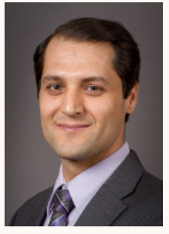
Project Information
Client: Prof. Abolfazl Razi
EE Faculty Member & Researcher :Arnau Rovira Sugranyes
Develop a system for Predictive routing algorithm which enables a delay-optimal communication through incorporating network topology prediction into the Dijkstra’s shortest path algorithm. In this work, we extend the proposed solution to jointly optimize the end-to-end latency and total transmission power.
Fahad almaraghi

Slide 3
Purpose
Improve efficiency of conventional networking methods
More research into field of Autonomous Robotics
Internet of Things
Various applications in Medical Civilian Military
Fahad almaraghi

Slide 4




Systems in play
Localization
Network
Platform
User Interface
Fahad almaraghi

Slide 5
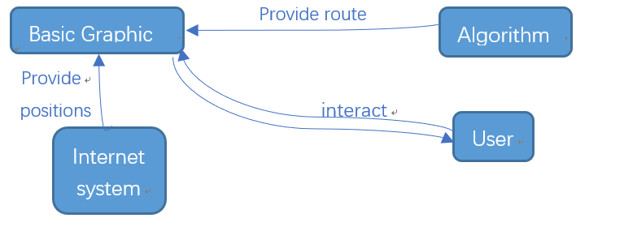
Methodology
User click a bottom on the GUI
GUI will generate some constants automatically (or user can set it manually)
The algorithm can predictive the optimal path using the initial constants and send the path to robots
Robots will start to run after they received the path.
The Camera robot will get the real path and compare with the optimal one and the conventional one.
We can run it again to get more experience data.
Chaoju Wang

Slide 6
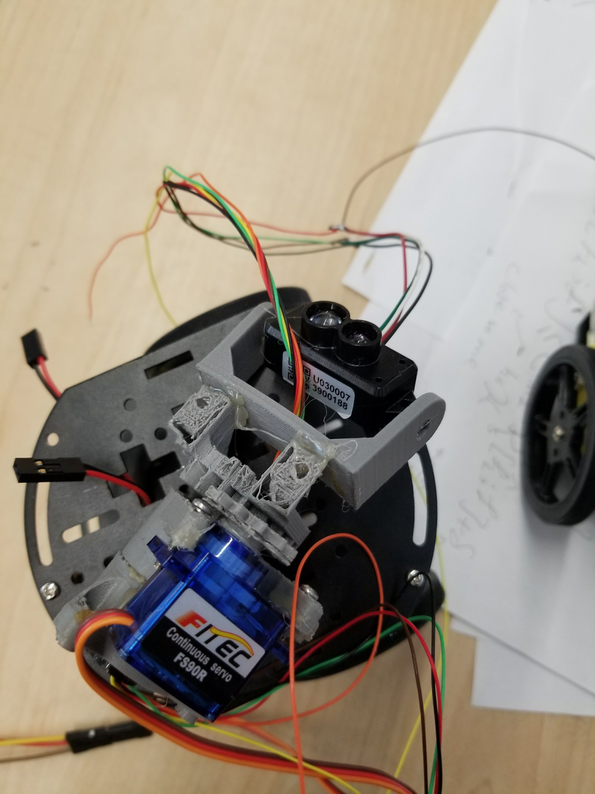
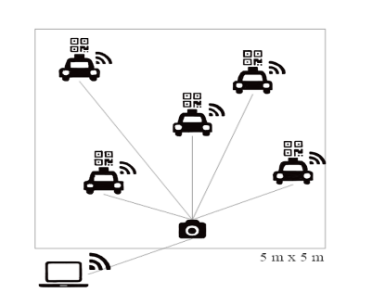
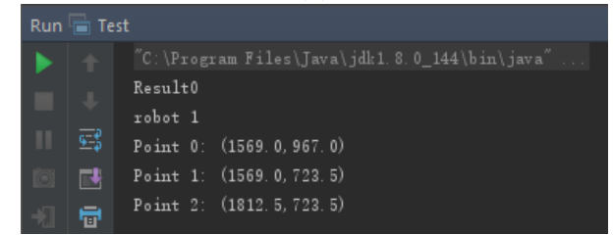
LIDAR + QR
Chaoju Wang

Slide 7
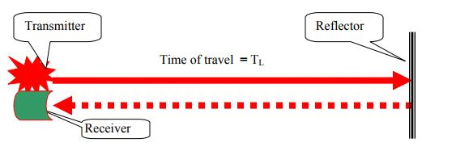
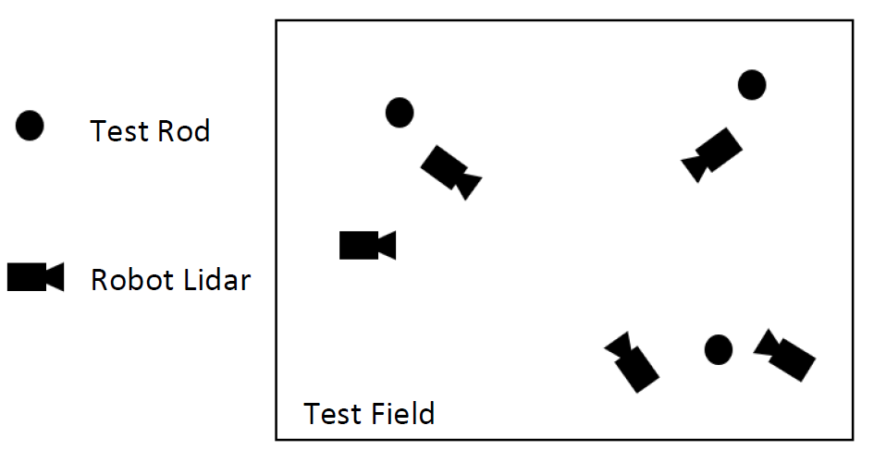
Scan a cycle to get the distances to 3 reference nodes. Filter the noise data.
Apply the 3 different distances to 6 possible combination and get at most 6 possible location with corresponding errors.
The least error one the the location we found.
Chaoju Wang

Slide 8
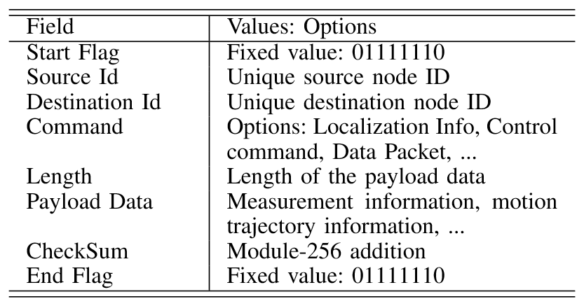
Network
Database
Wifi: The information exchange occurs between the CBCU and the robots through WiFi connectivity.
Communication Protocol: We select TCP/IP over WiFi (IEEE 802.11 family) connectivity.
The Source and Destination fields.
Sftp
Router
Unified Packet format
Qiyuan Huang

Slide 9
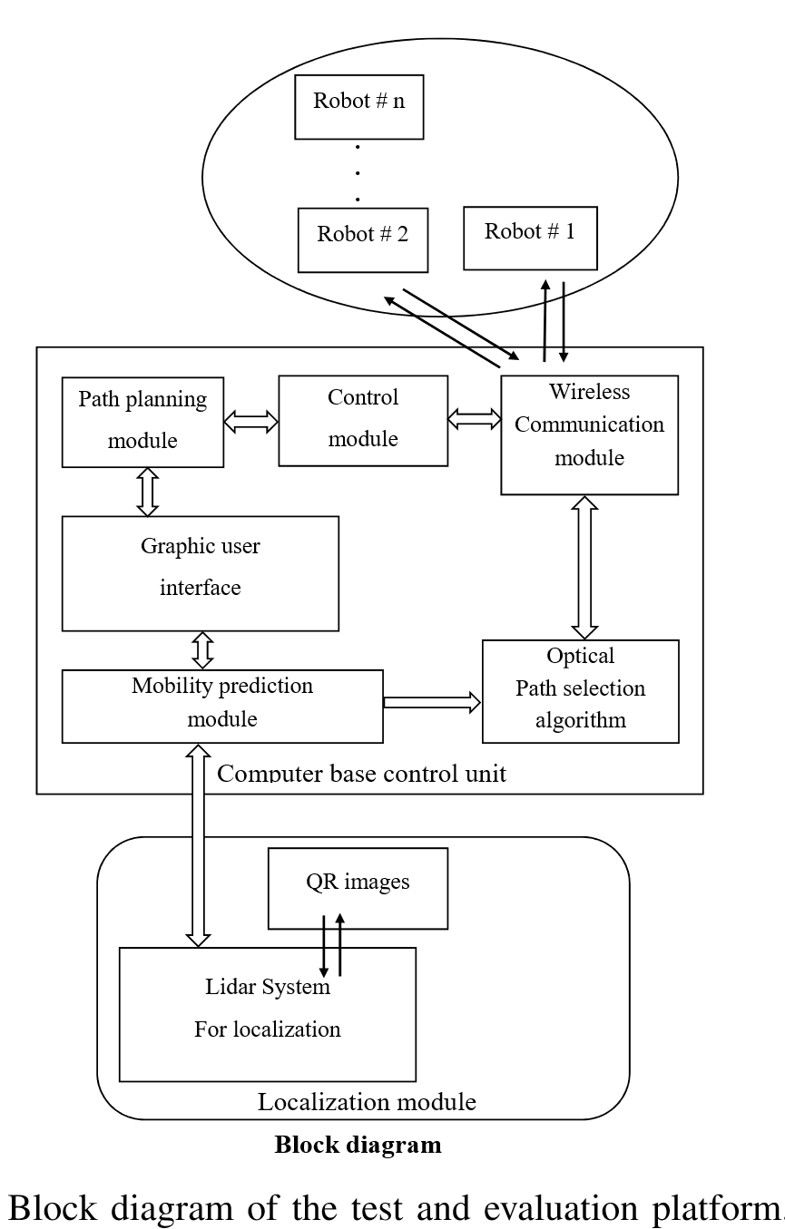
Network system:
The system consists of three main modules.
The control unit is developed in MATLAB environment with a graphic user interface (GUI)
The control unit includes path planning module (PPU) and control unit (CU)
PPU
CU
Qiyuan Huang

Slide 10
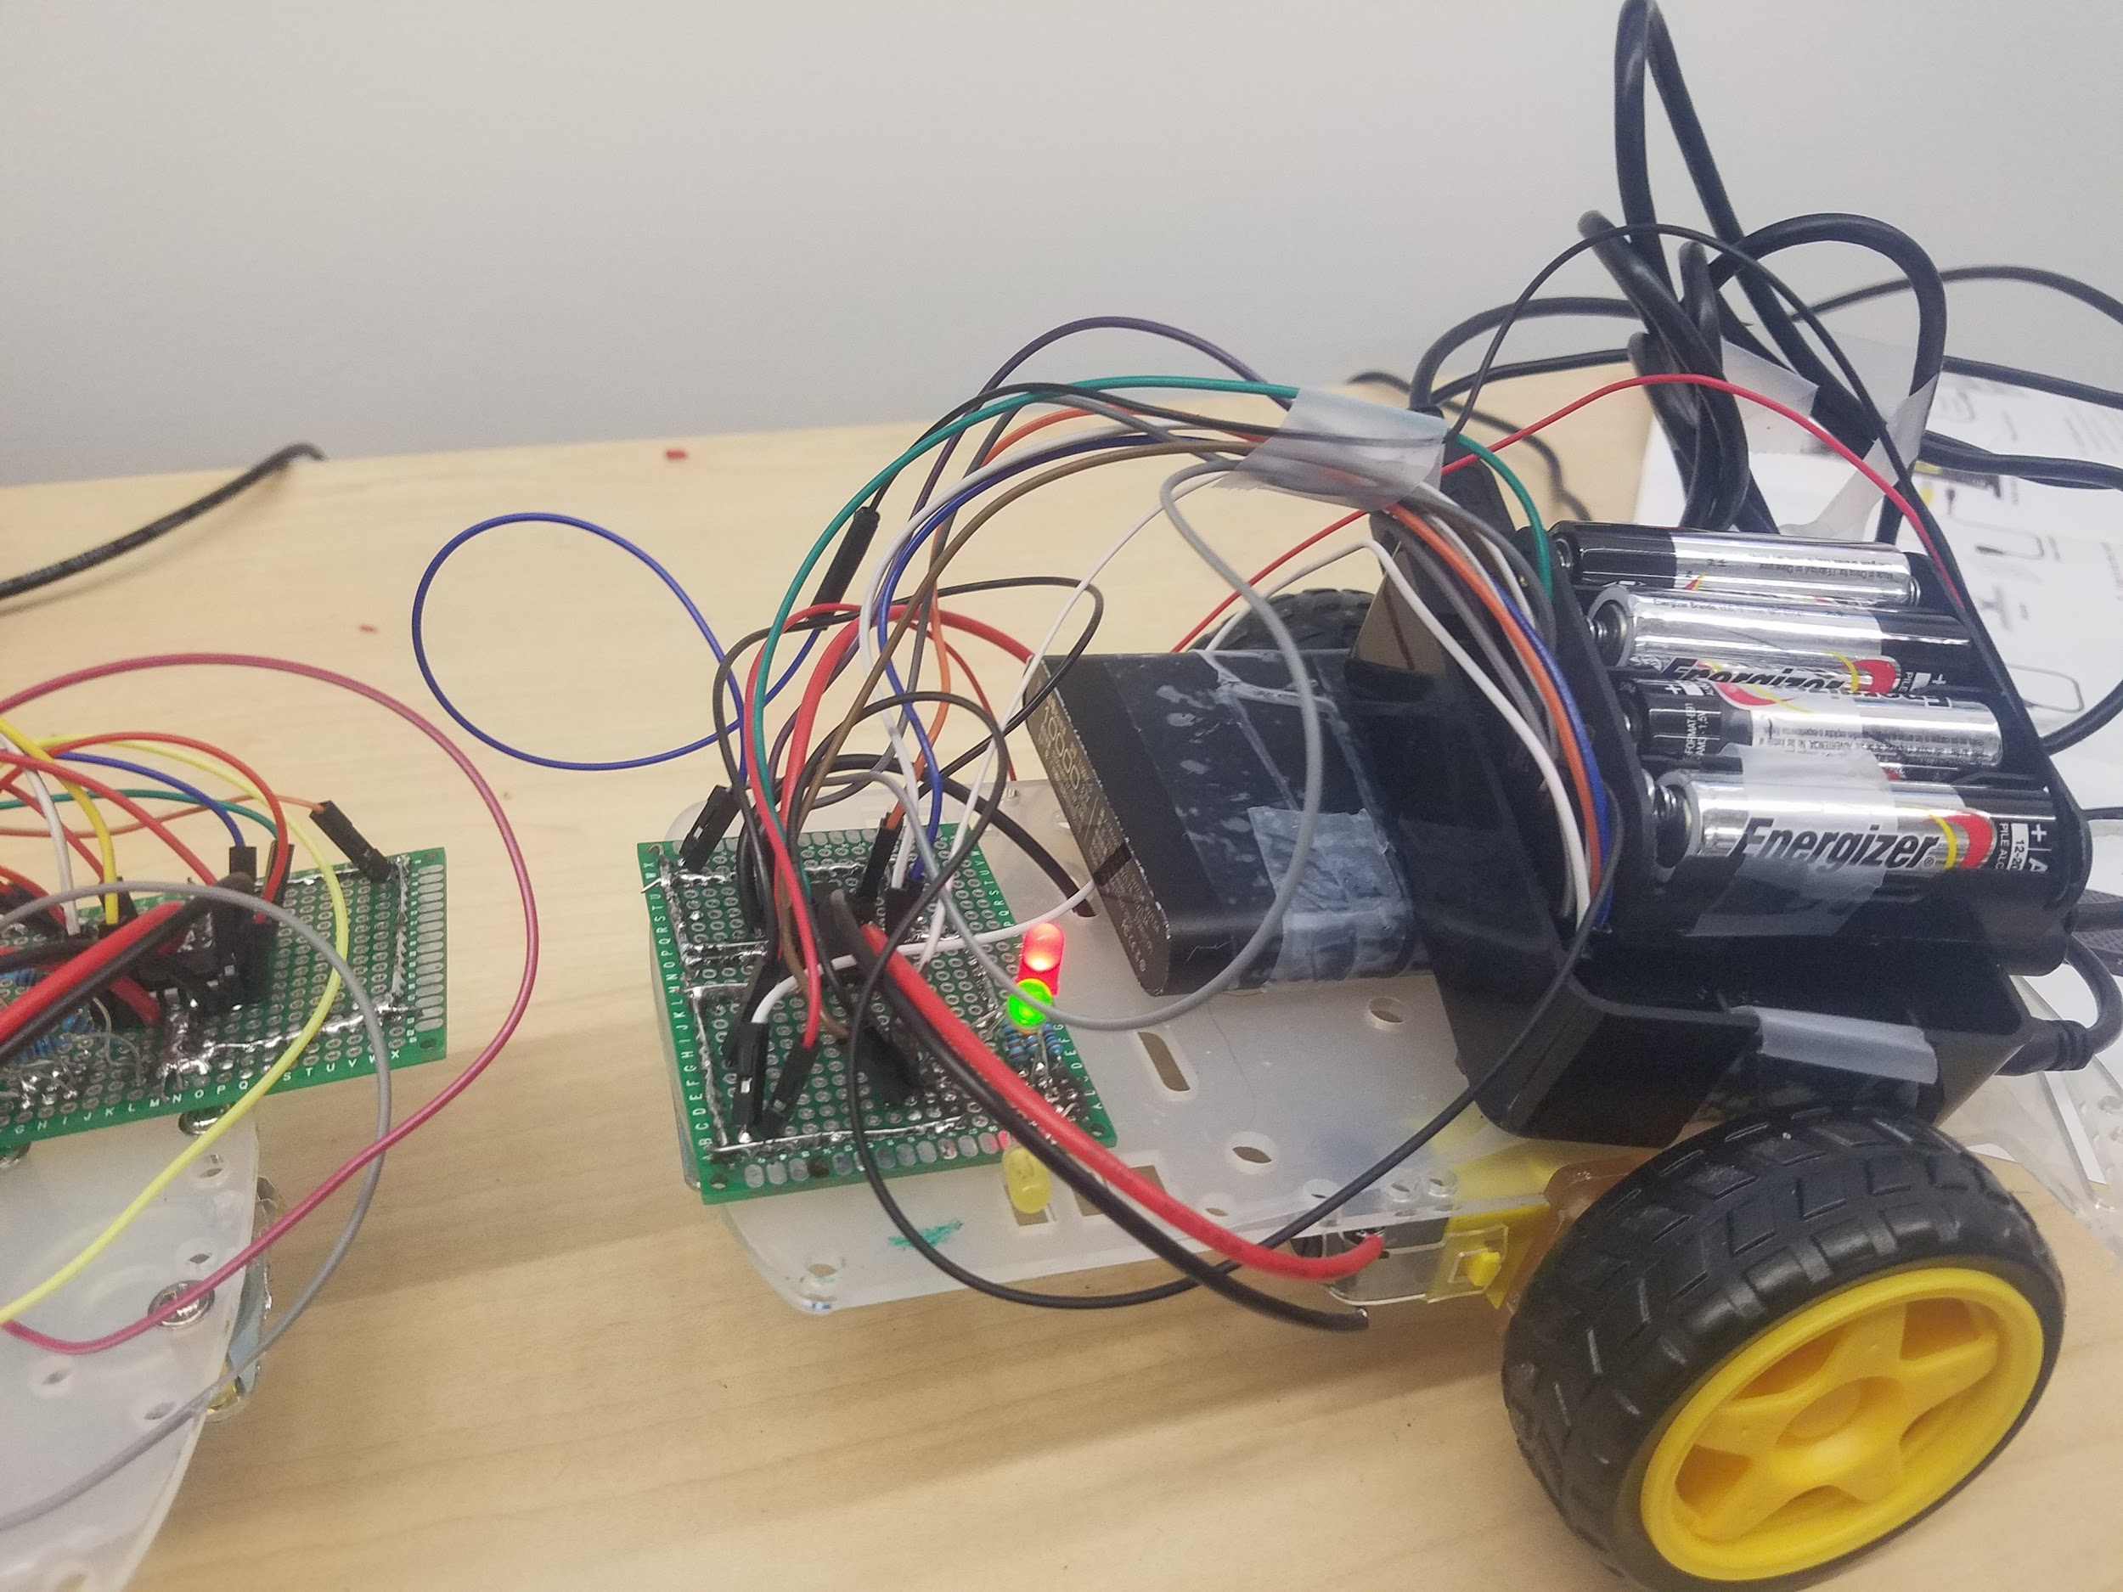
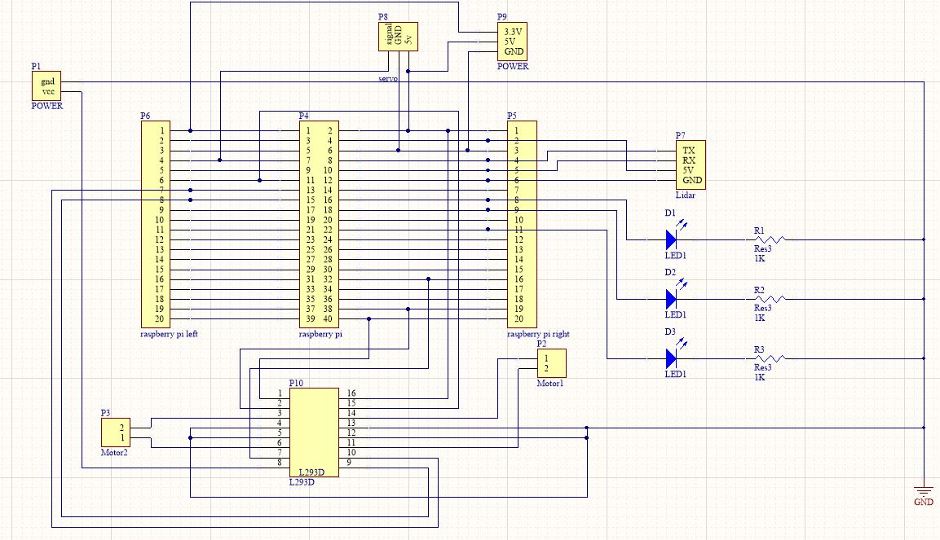
Platform
1x Lithium Ion Battery Pack
1x Lidar Mechanism
1x Robot car chassis
1x Raspberry Pi 3 b+ Microcontroller
1x PCB custom Board
3x LED’s
3x 1K Resistors
Hanxiao Lu

Slide 11
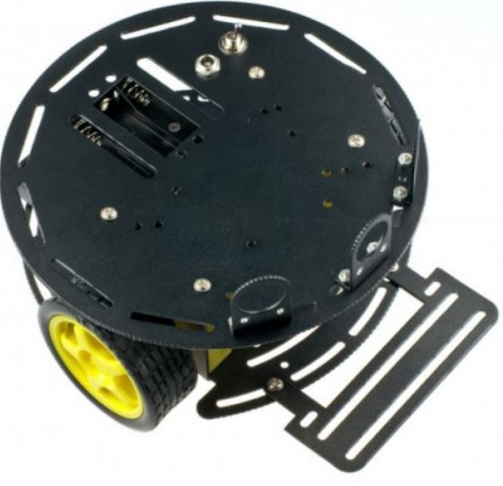
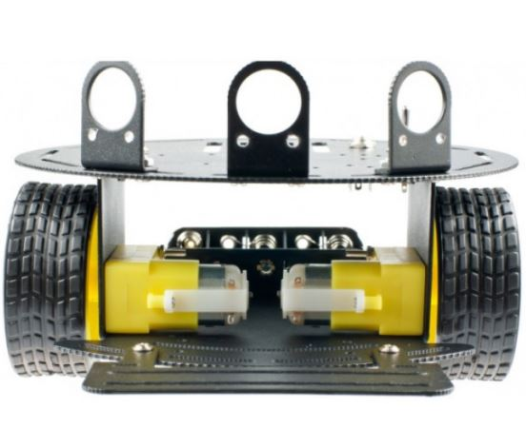
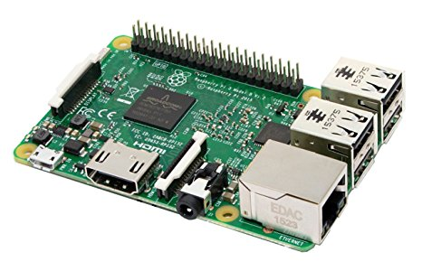
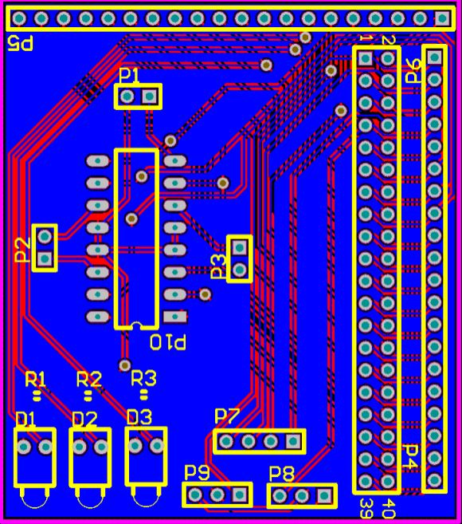
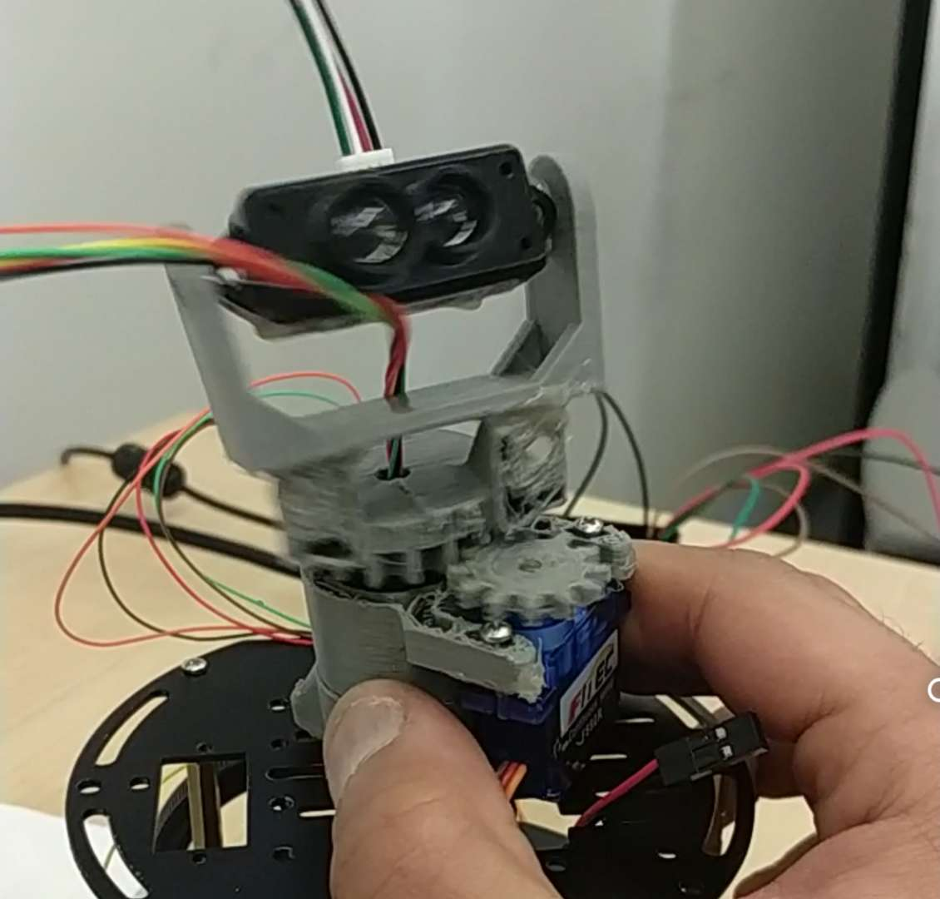
Platform
Raspberry pi
PCB
Motor + lidar
Hanxiao Lu

Slide 12
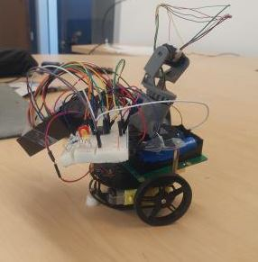
Prototype Platform
Hanxiao Lu

Slide 13
User Interface
Localization ( QR code system + Lidar System)
Send position
Database
Send position
Send position
Algorithm
GUI
Send path
Yuting Zhang

Slide 14
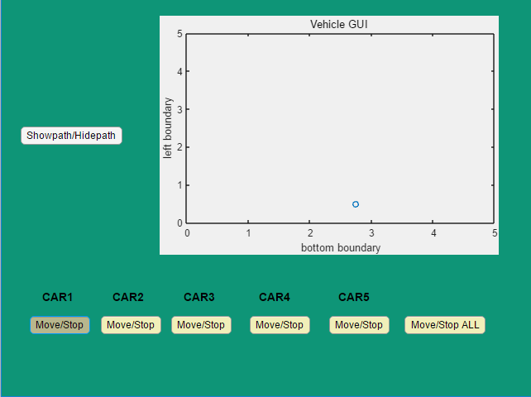
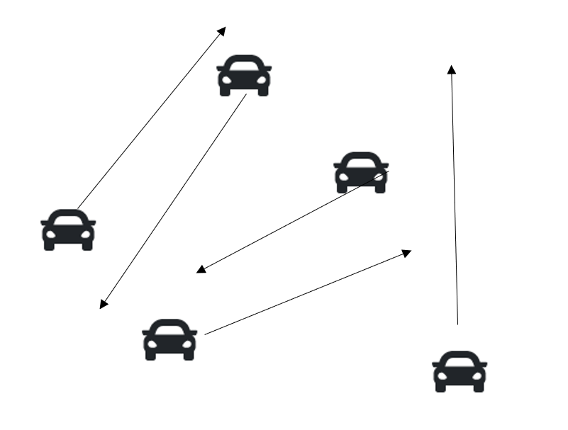
Control
Yuting Zhang

Slide 15
The Algorithm
Input:
N ------------------ Number of Nodes
Velx --------------- velocity matrix in x axis
Vely --------------- velocity matrix in y axis
Delay ------------- delay matrix for N nodes
Positionx --------- initial position in x axis
Positiony --------- initial position in y axis
Noise ------------ add some noise
Weight ------------ weight determined by time . and distance
Output:
Path -------------------- optimal path
Distance ---------------- distance from . destination
Time ---------------- time to arrive
. destination
Obj function -------------- for future use
Number of hops ----------- both normal and optimal, for comparison.
Yuting Zhang

Slide 16
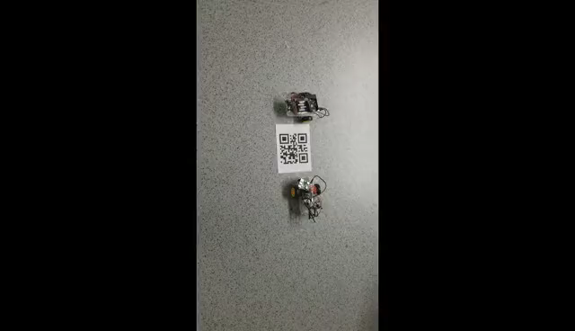
Results
Fahad almaraghi

Slide 17
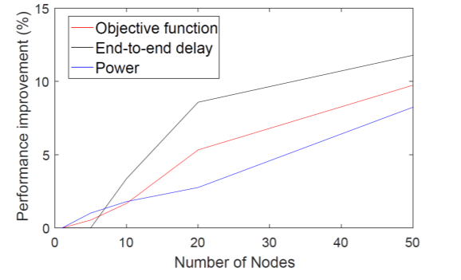
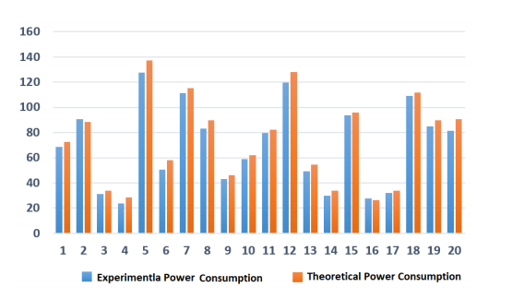
Results
Fahad almaraghi
Notes:
shows the effect of the number of nodes in the efficiency of the method proposed. It is observable that as number of nodes in the network increases, the optimal algorithm exhibits a higher performance improvement in terms of delay and power utilization compared to the conventional algorithm. The reason is that, more decision making are taken place for a larger network, and thereby there is larger margin between the two algorithms. Further, the network topology change is more extreme for larger networks, simply because it takes a longer time for a packet to reach the destination. For a network of 50 nodes, the performance of the optimal method shows about 10% improvement. For a larger network, this improvement is expected to rise.

Slide 18
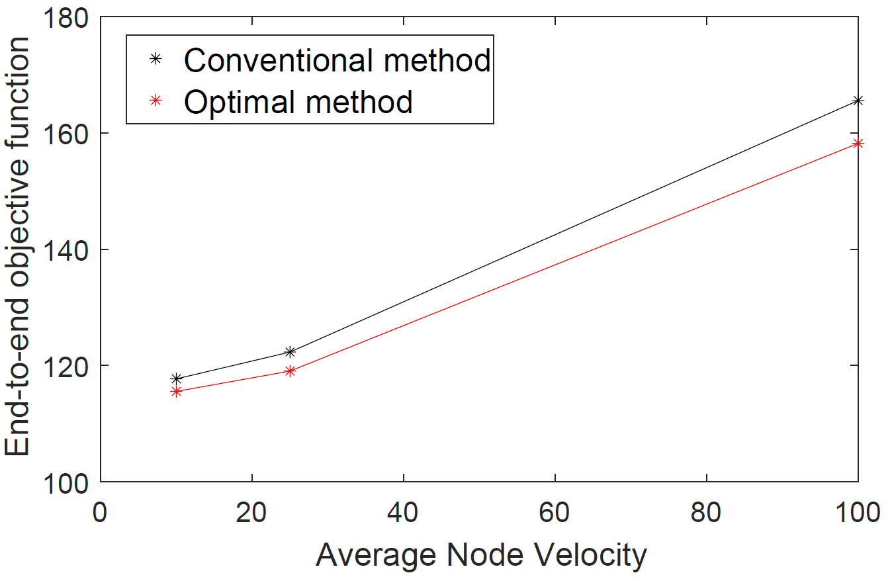
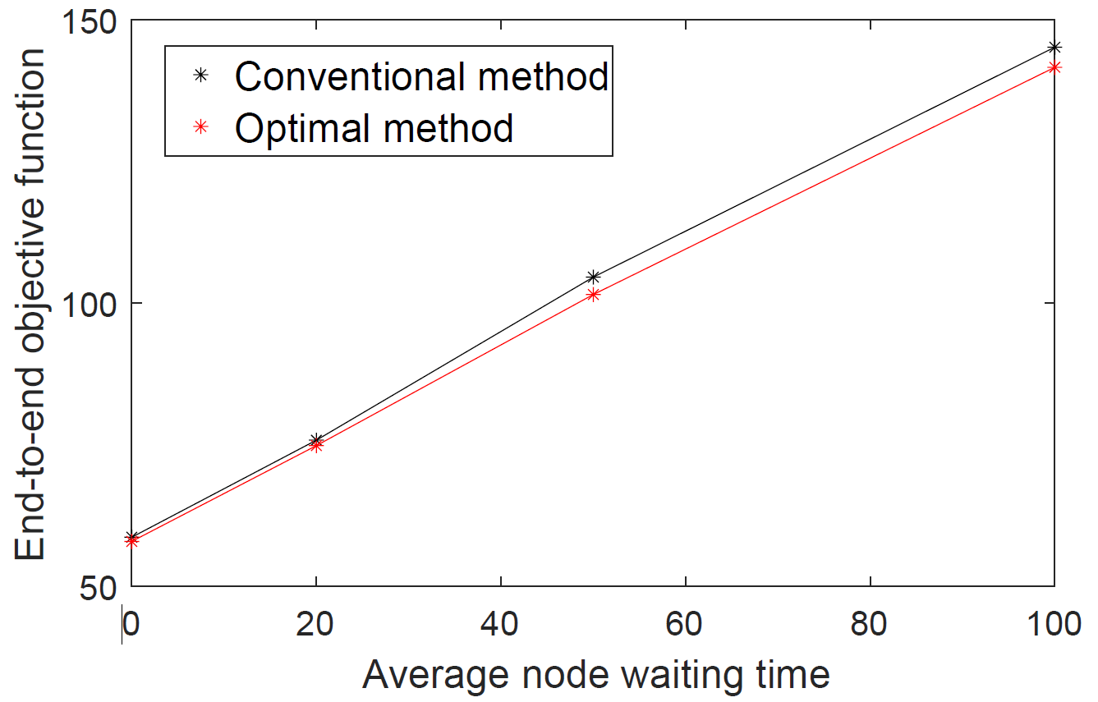
Results
Fahad almaraghi
Notes:
As we increase the waiting time for each node, topology changes are more severe and we obtain higher gains by predicting network topology. Therefore, substantial benefits can be obtained for queued networks with heavy traffic mode
Lastly, we test the performance gain with respect to the average node velocity. For more dynamic networks, where the node velocities are higher, the optimal method improves compared to the conventional, as shown in Fig. 9. The reason is that for higher node velocities the network topology is evolving rapidly and consequently, the proposed algorithm shows a better performance. For this reason, the proposed algorithm is well suited to FANET with fast-flying objects

Slide 19
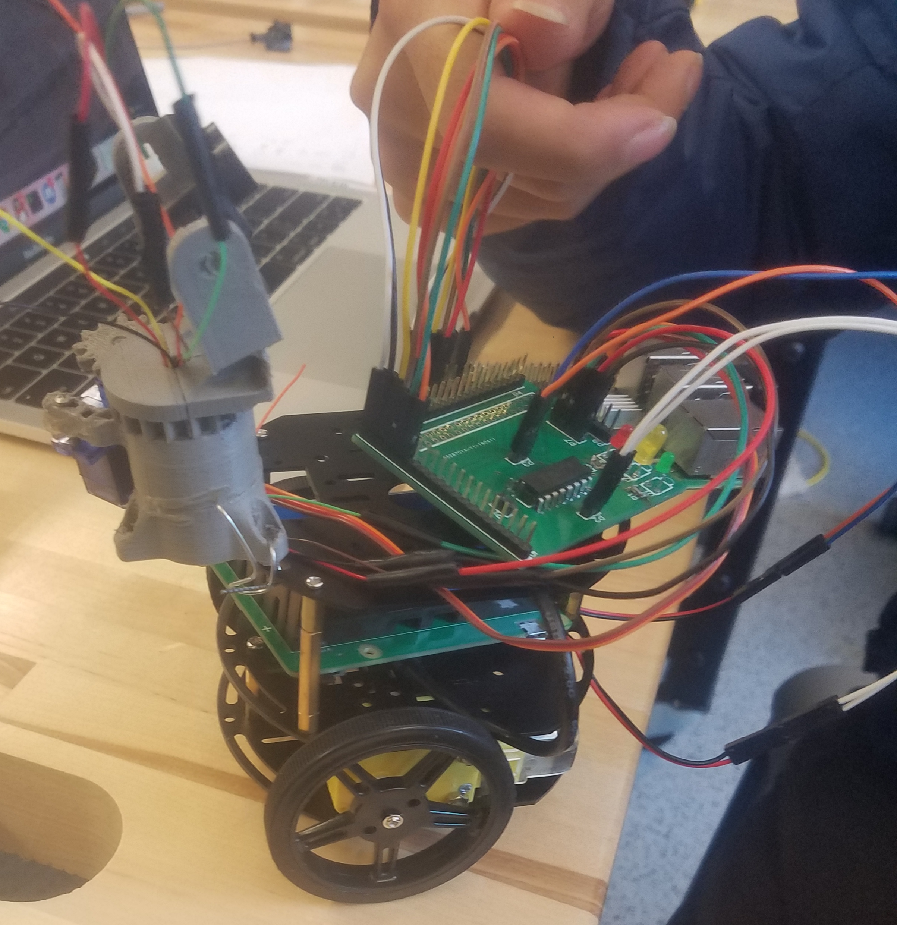
Final Product
Raspberry Pi 3 Model B+
Custom PCB
Chassis
Lidar
Lidar Mechanism
Database
GUI
Network
The Algorithm
External Power Pack
Fahad almaraghi

Slide 20
Conclusion
10% Increase in Efficiency for Moderate sized Networks
High gains for more nodes
High traffic Networks gain more
Highly Dynamic Networks Gain more
Fahad almaraghi

Slide 21
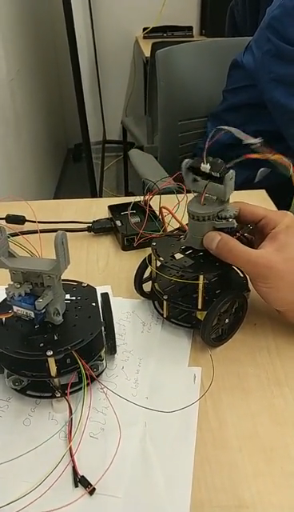
Video

Slide 22
Q&A

